Slide 1

https://sahibulsaif.wordpress.com/wisdom/bismillah-nature/

Slide 2
THE Database Approach
CSC271 – DATABASE SYSTEMS
LECTURE - 03

Slide 3
Previous Lecture Overview

Slide 4
Today’s Lecture
In this lecture, you will learn about:
Database approach
Advantages of Databases
History of Databases

Slide 5
The DATABASE Approach
Central repository of shared data. Data is managed by a controlling agent Stored in a standardized, convenient form.
Controlling agent is named as Database Management System (DBMS).
DBMS:
A software system that is used to create, maintain, and provide controlled access to user databases

Slide 6
The DATABASE Approach
Order Filing
System
Central database
Contains employee,
order, inventory,
pricing, and
customer data
Invoicing
System
DBMS
Payroll
System
DBMS manages data resources like an operating system manages hardware resources.

Slide 7
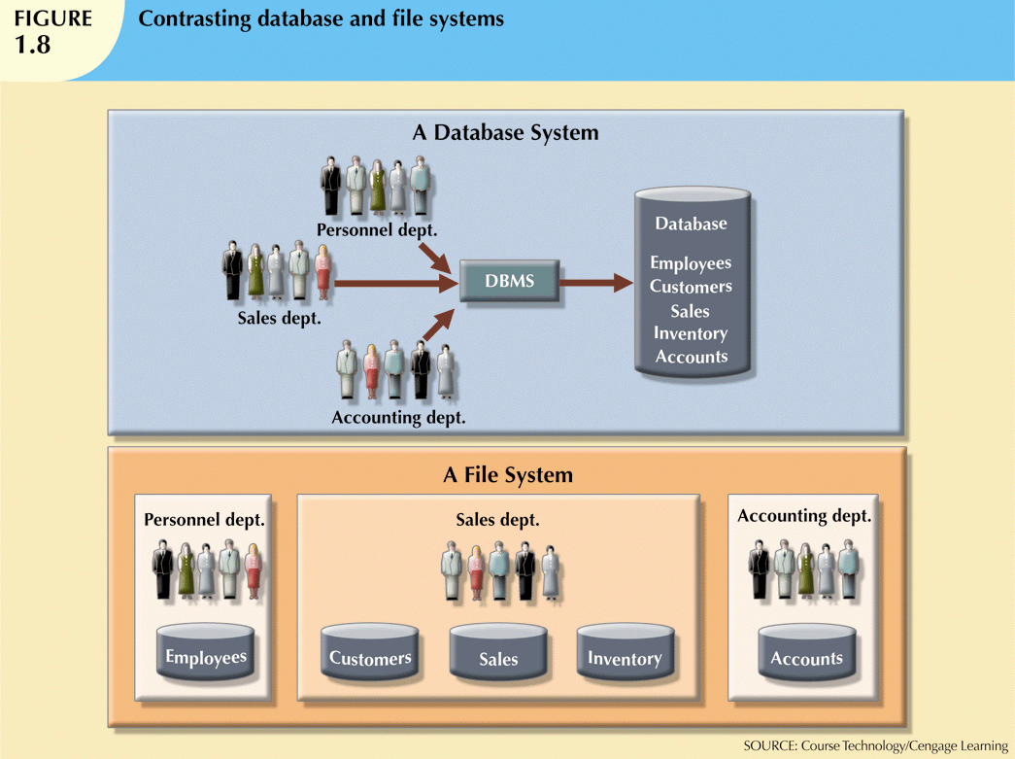
Database Approach vs File Based Systems

Slide 8
Advantages of Database Approach
Program-Data Independence
Metadata stored in DBMS, so applications don’t need to worry about data formats
Data queries/updates managed by DBMS so programs don’t need to process data access routines (reading/writing etc.)
Results in: increased application development and maintenance productivity
Minimal Data Redundancy
Leads to increased data integrity/consistency

Slide 9
Advantages of Database Approach
Improved Data Sharing
Different users get different views of the data
Enforcement of Standards
All data access is done in the same way
Improved Data Quality
Constraints, data validation rules

Slide 10
Advantages of Database Approach
Better Data Accessibility/ Responsiveness
Use of standard data query language (SQL)
Security, Backup/Recovery, Concurrency
Disaster recovery is easier

Slide 11
Costs of Database Approach
Up-front costs:
Installation Management Cost and Complexity
Conversion Costs
Ongoing Costs
Requires New, Specialized Personnel
Need for Explicit Backup and Recovery
Organizational Conflict
Old habits die hard

Slide 12
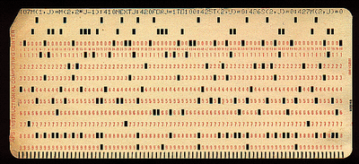
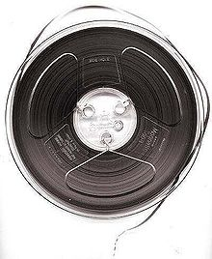
History of Database Systems
1950s and early 1960s:
Data processing using magnetic tapes for storage
Tapes provided only sequential access
Punched cards for input

Slide 13
History of Database Systems
Late 1960s and 1970s:
Hard disks allowed direct access to data
Network and hierarchical data models in widespread use
Ted Codd defines the relational data model
Would win the ACM Turing Award for this work
IBM Research begins System R prototype
High-performance (for the era) transaction processing

Slide 14
History of Database Systems
1980s:
Research relational prototypes evolve into commercial systems
SQL becomes industrial standard
Parallel and distributed database systems
Object-oriented database systems
1990s:
Large decision support and data-mining applications
Large multi-terabyte data warehouses
Emergence of Web commerce

Slide 15
History of Database Systems
Early 2000s:
XML and XQuery standards
Automated database administration
Later 2000s:
Giant data storage systems
Google BigTable, Yahoo PNuts, Amazon

Slide 16

http://www.thomasformo.com/category/qa/

